Slide 1
Travel agent
AICTE & IBM PROJECT
Student name : Atifa Meraj
College Name : K.N.I.T., Sultanpur
Department : Electronics Engineering

Slide 2
OUTLINE
Problem Statement
Technology used
Wow factor
End users
Result
Conclusion
Git-hub Link
Future scope
IBM Certifications

Slide 3
Problem Statement
A Travel Planner Agent is an AI-powered assistant that helps users plan trips efficiently and intelligently. It uses real-time data to suggest destinations, build itineraries, and recommend transport and accommodation options. By understanding user preferences, budgets, and constraints, it tailors personalized travel plans. Integrated with maps, weather updates, and local guides, it ensures a smooth travel experience. The agent can also manage bookings, alert users to changes, and optimize schedules on the go. This smart assistant transforms complex travel planning into a seamless, enjoyable process.

Slide 4
Technology used
IBM cloud lite services
Natural Language Processing (NLP)
Retrieval Augmented Generation (RAG)
IBM Granite model

Slide 5
IBM cloud services used
IBM Cloud Watsonx AI Studio
IBM Cloud Watsonx AI runtime
IBM Cloud Agent Lab
IBM Granite foundation model

Slide 6
Wow factors
Our Travel Planner Agent stands out with its intelligent, real-time capabilities that transform travel planning into a smooth, personalized experience. By leveraging IBM Cloud Lite and AI models like IBM Granite, the agent dynamically adapts to user preferences, budget, and schedule changes. It offers smart itinerary generation, live updates, booking automation, and local recommendations—all in one platform.
Unique features:
AI-driven personalized travel planning based on user preferences and budget.
Real-time itinerary updates using live weather, traffic, and transport data.
Unified platform combining maps, bookings, guides, and alerts.
Seamless integration of IBM Granite and IBM Cloud Lite for scalable AI.
Goal-based trip suggestions like adventure, relaxation, or budget travel.

Slide 7
End users
Travel Enthusiasts & Bloggers
Families
Event Planners & Corporate Teams
Business Travelers
Students & Backpackers
Elderly or Assisted Travelers

Slide 8
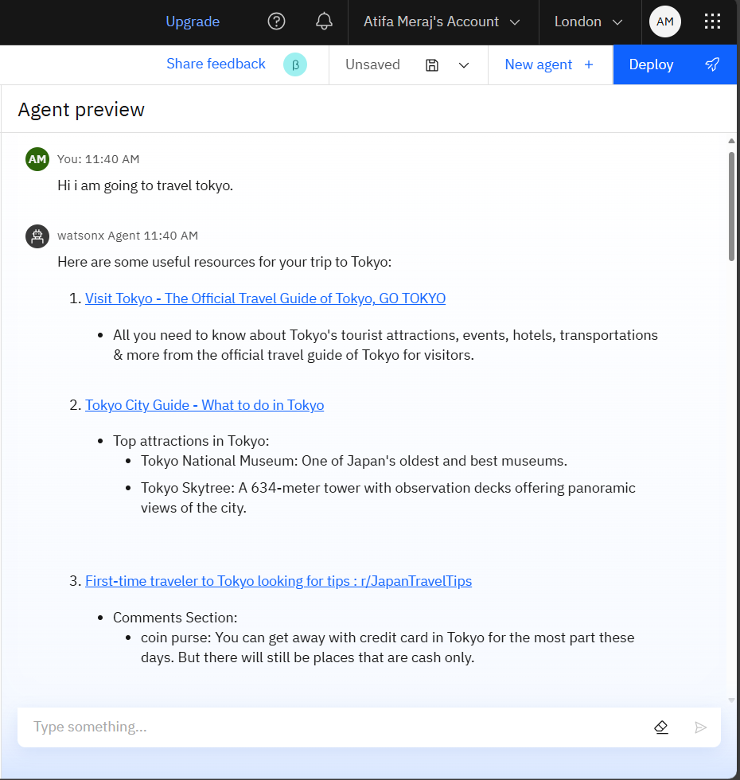
Results

Slide 9
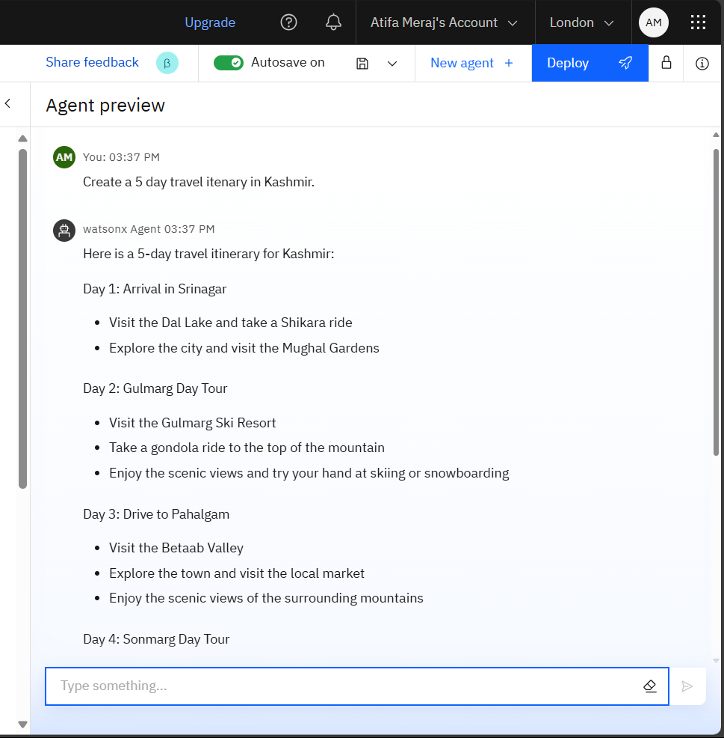
Results

Slide 10
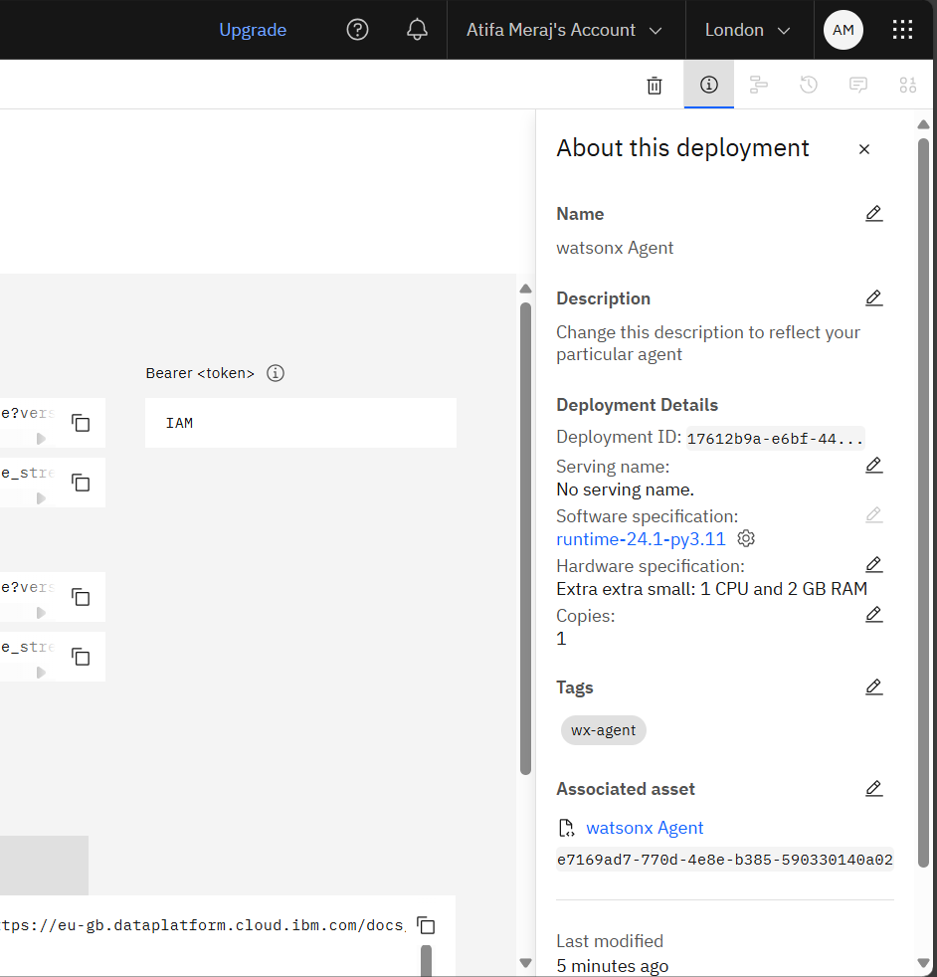
Results

Slide 11
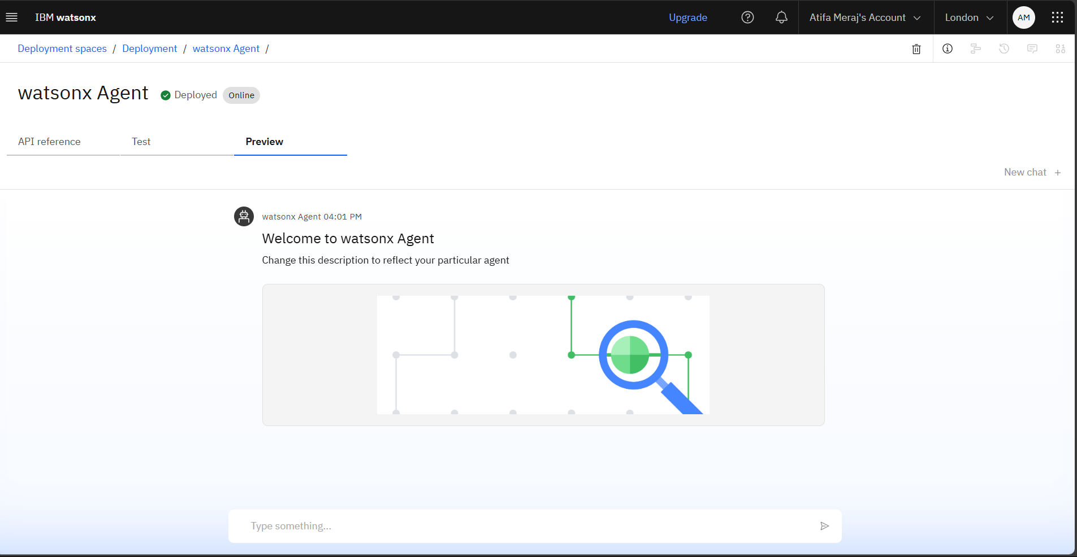
Results
Deployed AI Agent

Slide 12
Conclusion
The Travel Planner Agent simplifies complex travel planning through AI and real-time data.
It offers a highly personalized experience based on user preferences, budget, and travel goals.
Suitable for a wide range of users—from solo travelers to corporate teams.
Transforms traditional trip planning into an efficient, enjoyable, and intelligent process.

Slide 13
Future scope
Voice Assistant Integration
Multi-Language Support
Real-Time Collaboration Features
Predictive Planning
Emergency Assistance
AI-Powered Expense Tracking & Budget Optimization

Slide 14
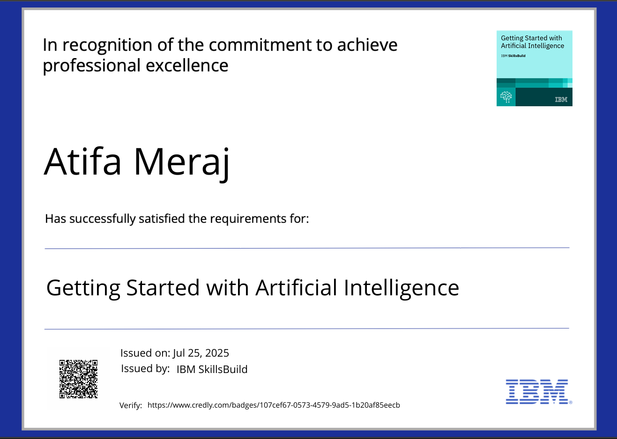
IBM Certifications

Slide 15
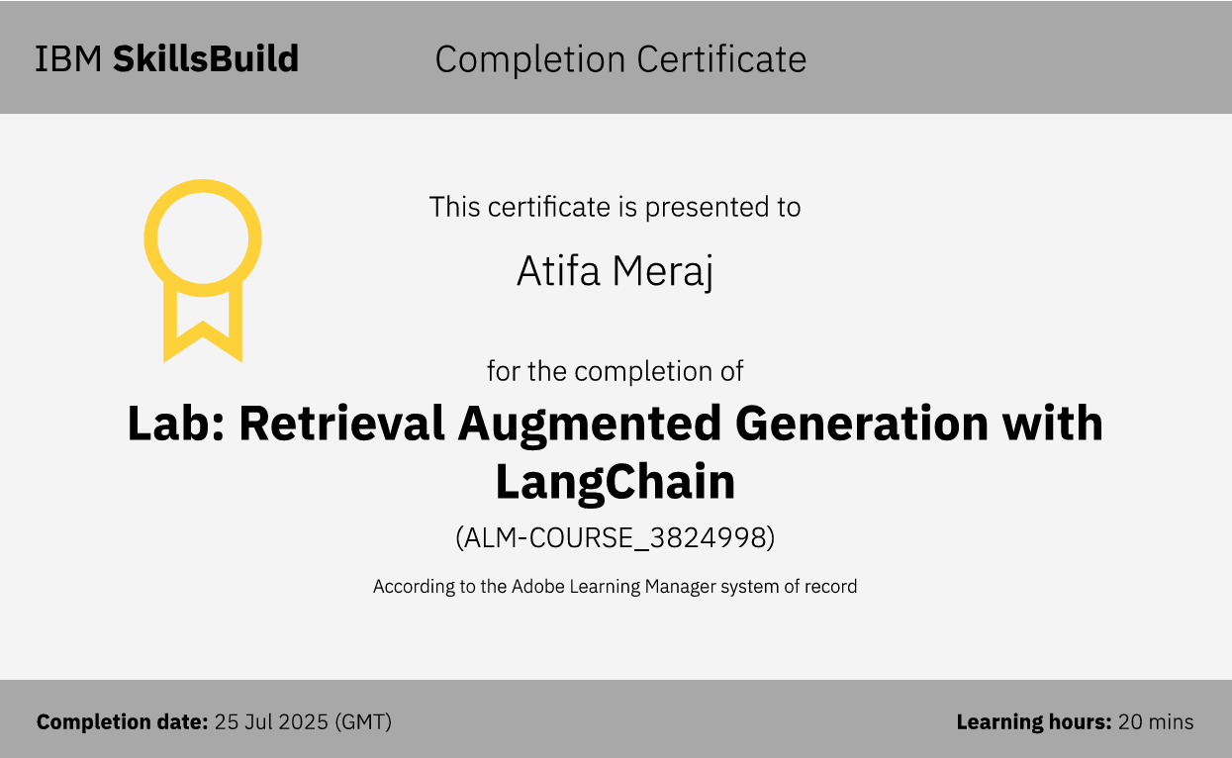

Slide 16
GitHub Link
Click here for the github link: travel-agent-ai

Slide 17
THANK YOU

